Slide 1


CBC News
Re-design the webpage for
Tina L Cao
Notes:
Hi, welcome to my presentation on the redesign of my webpage

Slide 2


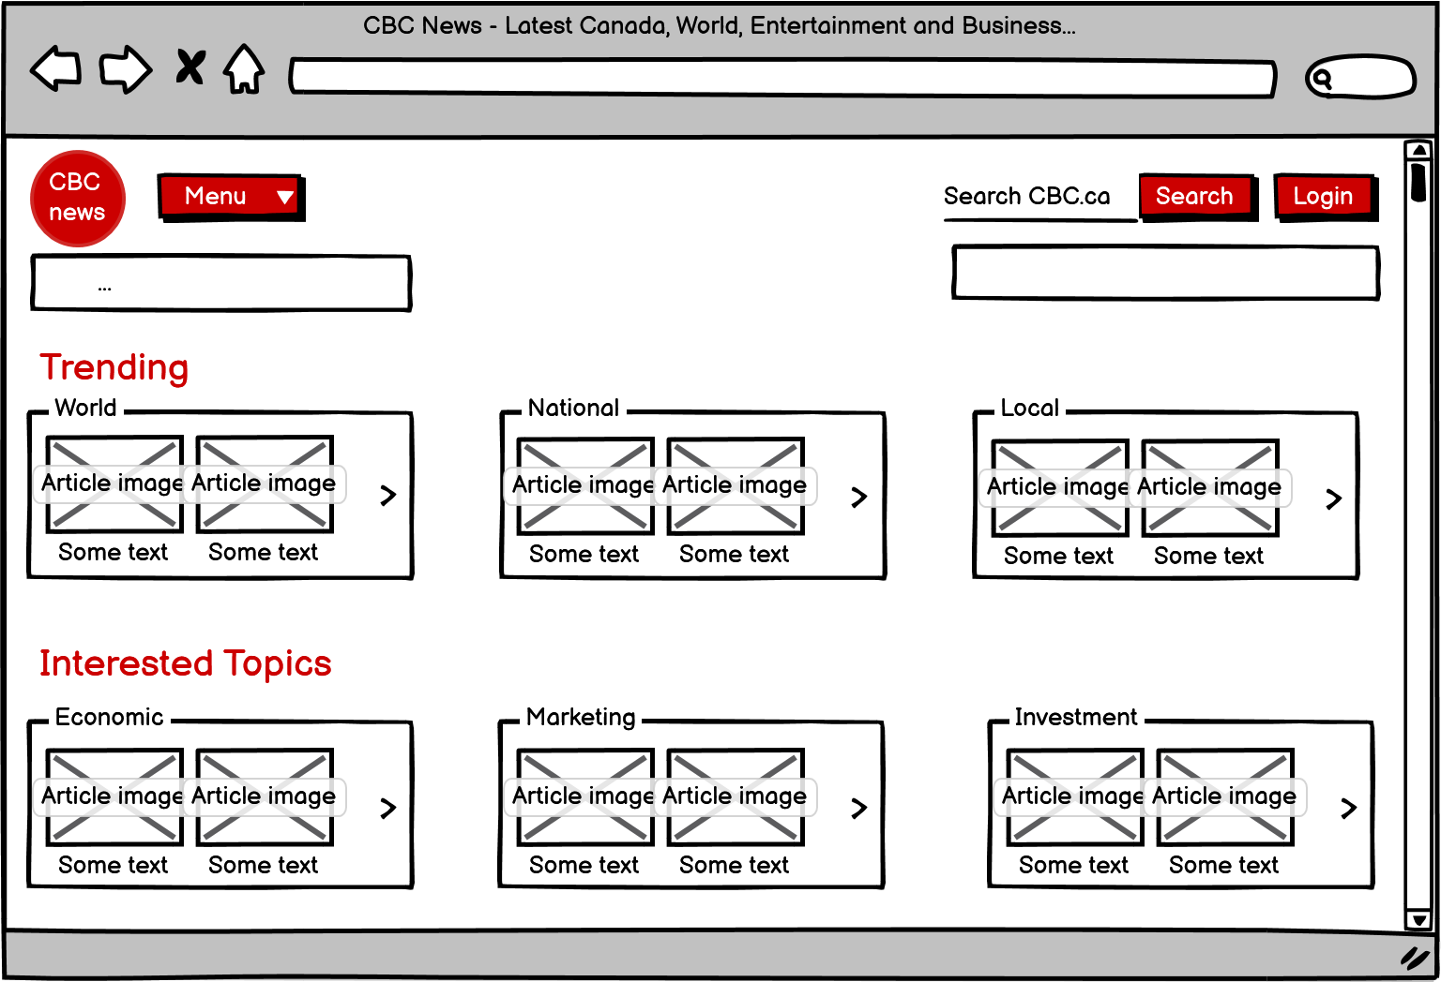
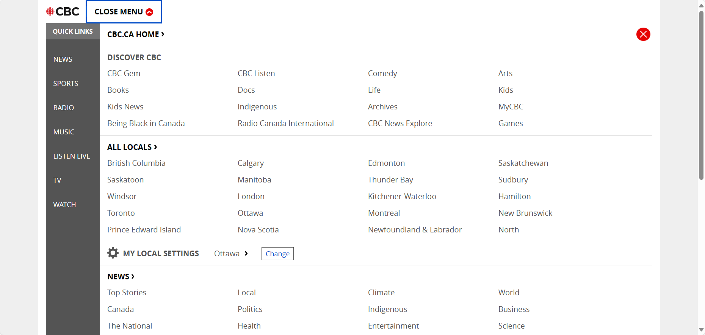
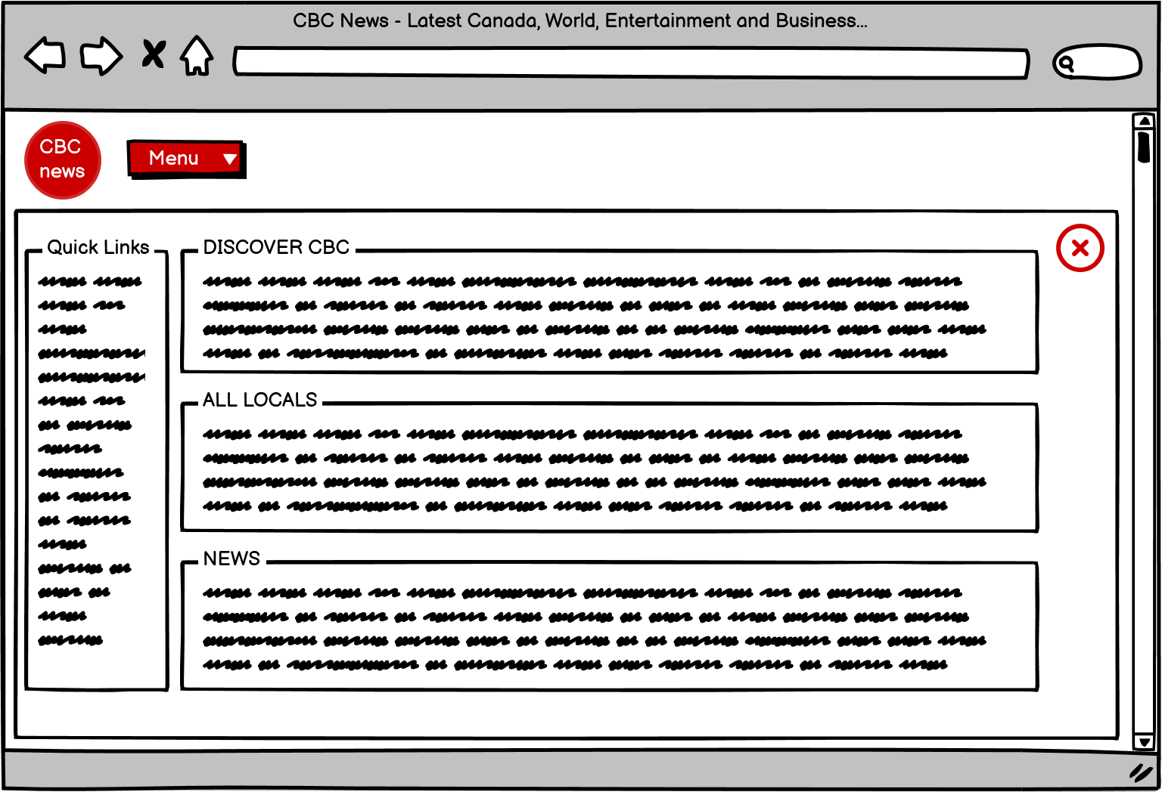

CBC News - Interface
Original Layout
Updated Layout
Notes:
I've chosen the CBC News as my interface because it offers a wide range of news in different topics. However, I noticed that in the original layout, the comment sections within articles were somewhat blended with the surrounding content, and I found them a bit inconvenient to find.

Slide 3

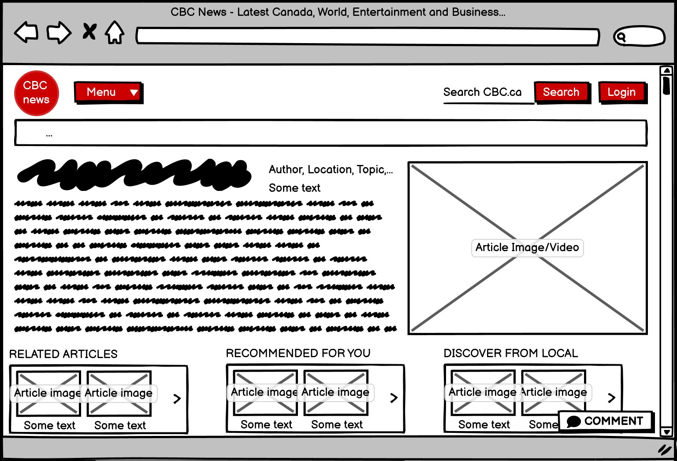
CBC News – Task and Motivation
Transforming the comment section into a pop-up window
Original Layout
Updated Layout
Notes:
So, my task was to update the comment section by turning it into a pop-up window which makes it easier to locate. As you can see in the wireframe image here.

Slide 4
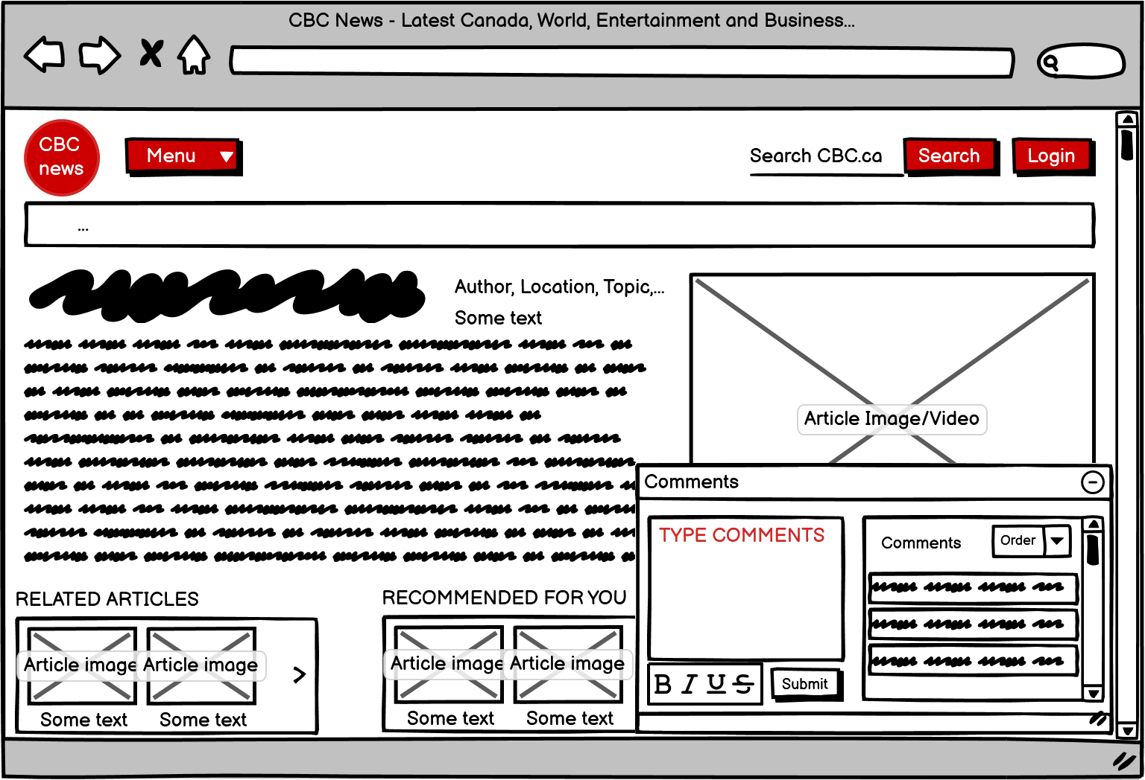
CBC News – Goals and Hypothesis
Determine which version yields greater satisfaction
Enhance visibility of the comment section
The updated interface reduces memory workload
Notes:
The objectives of the redesign are: first, to determine which version of the interface yields greater user satisfaction, and second, to enhance the visibility of the comment section.
My hypothesis is that the updated interface will reduce the cognitive workload for users.

Slide 5
CBC News - Experiment
Participants: 5 experienced friends
Location/Setup: Online via Zoom
Type: Within-subject
Equipment: A computer/laptop connected to Internet, Consent form, Questionnaire form, Script
Notes:
For this experiment, I'll be inviting 5 experienced users who are friends of mine. The experiment will be conducted online using Zoom. It's a within-subject experiment, and it will need a computer or a laptop with internet access, a consent form, a questionnaire, and a script.

Slide 6
CBC News - Experiment
Independent variables: Original interface and New interface
Dependent variables: Time
Procedure #1: Participants sign a consent form
Procedure #2: Participants use both original and updated version (on Wireframe)
Procedure #3: Participants fill in a short questionnaire after the interaction
Notes:
The independent variables are the original interface and the new interface, while the dependent variable is time.
During the experiment, participants will first sign the consent form. Then, they will interact with both the original and updated interfaces. After the interaction, participants will complete the questionnaire to provide feedback for further analysis.

Slide 7

CBC News - End
Thank you for watching!
Notes:
That concludes my presention, and thank you for watching.

